Slide 1
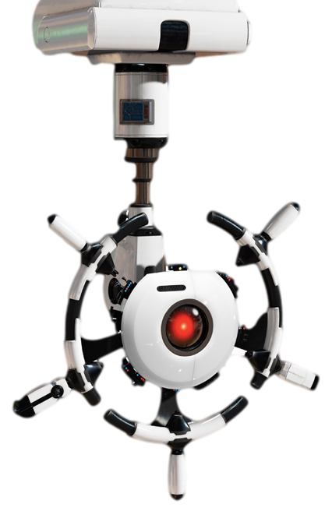




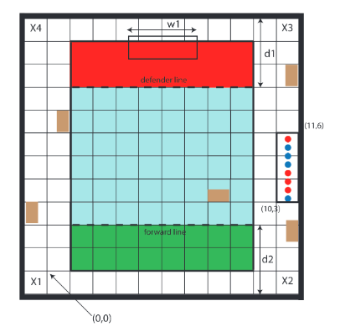
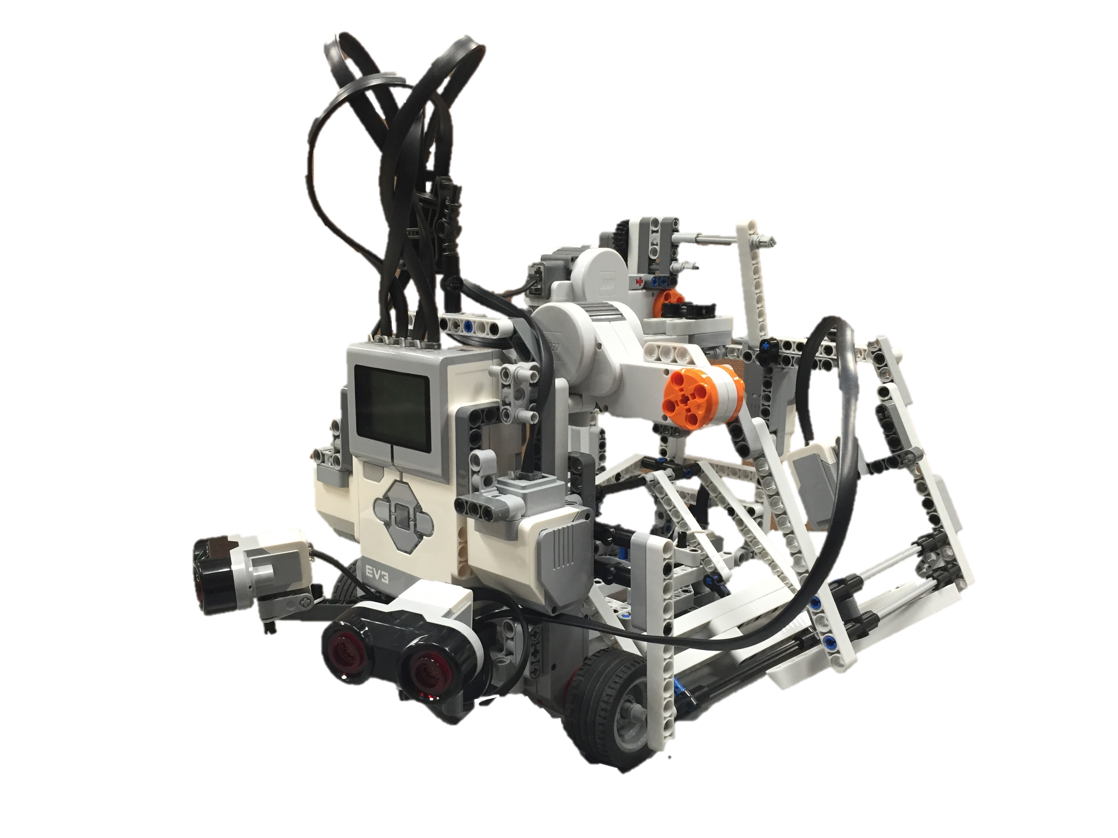
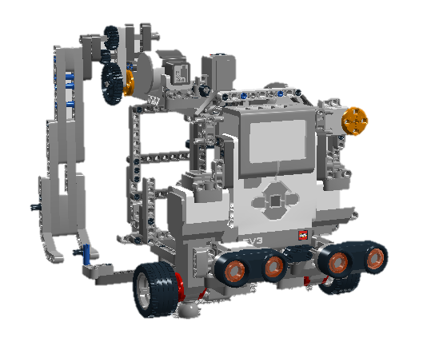
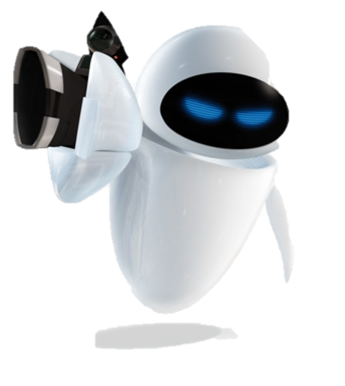
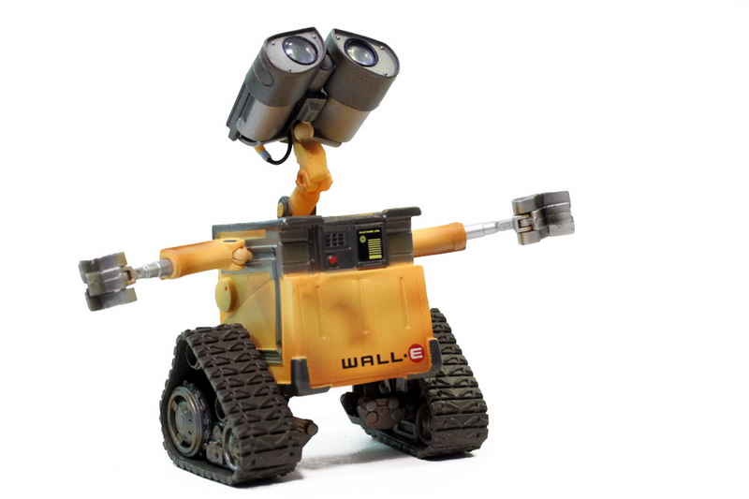
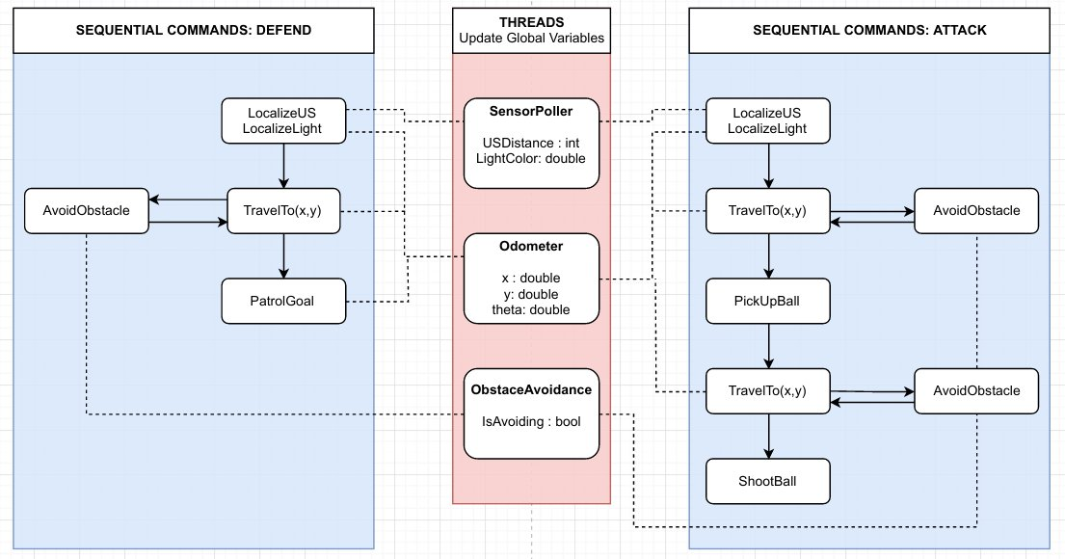
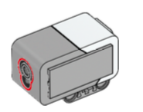
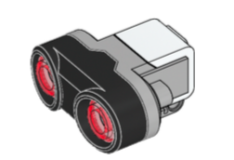
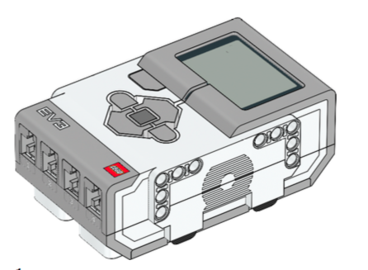
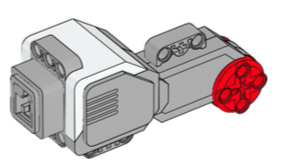
OBJECTIVE.
HARDWARE.
SOFTWARE.
Construct an autonomous, one-on-one soccer-playing robot capable of operating in either an offensive or defensive position with a 12’ x 12’ enclosure
Comp
General: 2 rounds – forward and defender (total of 4 runs)
Floor : nine 4’x4’ hardwood-covered metal panels
Obstacles: wooden blocks (randomly placed)
Game Time Constraint: 5 minutes
Robot tasks:
Completion of localization within 30 seconds
Obstacle avoidance
Accurate Navigation
Ball collection and color identification
Ball launching
Wi-Fi parameter transmission
Only offense can use their ultrasonic sensor
FEATURES
EV3 BRICK: Programmable with the LeJOS firmware and the Java programming language
MOTORS (4):
Each side of the robot – motion of the robot
Top left – launching arm
Top right – ball collector SENSORS (4):
2 Ultrasonic Sensors estimation of distance of the objects
1 Light Sensor verification of the correct color of the ball
1 Light Sensor localization
GEARS: Launching arm motion stability and power increase.
RAMP: Direct collected balls to the funnel.
LAUNCHING ARM: Projection of the ball into the goal
BALL COLLECTOR: Collection of the ball and direction to the launching area.
FUNNEL: Assurance of the ball collection.
BLOCK DIAGRAM
GOAL: map general pieces of software architecture
SQUARES major blocks (more general concepts)
CIRCLES: minor blocks (more specific concepts)
GENERAL PROCEDURE.
OFFENSE
Localization
Navigation (with obstacle avoidance) to offense zone– along the walls of the board
Navigation to the ball rack
Ball collection
Ball loading (with color identification) – ready for launch
Ball launching – towards the goal
THREADING DIAGRAM
Blue: Sequential commands (always beginning with localization)
Red: Continuously executing threads
Important: Evaluation of global variables (dependent on the robot's position and sensor reading)
DEFENSE
Localization
Arm extension – for a wider robot
Navigation to defense zone
Patrol
BUDGET.
MATERIALS.
 | Garret Holt | Sung Hong | Nawras Rabanni | Matthew Rodin | Tiffany Wang | Toy Yang | Total
Total Hours | 51.5 | 47.5 | 47.5 | 50.0 | 57.5 | 45.5 | 299.5
Avg./week | 8.58 | 7.92 | 7.92 | 8.33 | 9.58 | 7.58 | 8.29
LEGO MINDSTORMS EQUIPMENT
1 x EV3 Programmable Brick
1 x Rechargeable Battery
4 x Cable (10in)
4 x Cable (14in)
4 x Large Motor
2 x Ultrasonic Sensor
2 x Color Sensor
3RD PARTY MATERIAL
1x Roll of Scotch Tape – 2.50$
1x Poster – 17.00$
2 x USB Key – 5.00$
PERCENTAGE OF TOTAL BUDGET USED
Garret Holt, Sung Hong, Nawras Rabbani, Matthew Rodin, Tiffany Wang & Troy Yang
COLOR SENSOR ULTRASONIC SENSOR
EV3 PROGRAMMABLE BRICK LARGE MOTOR

